Slide 1
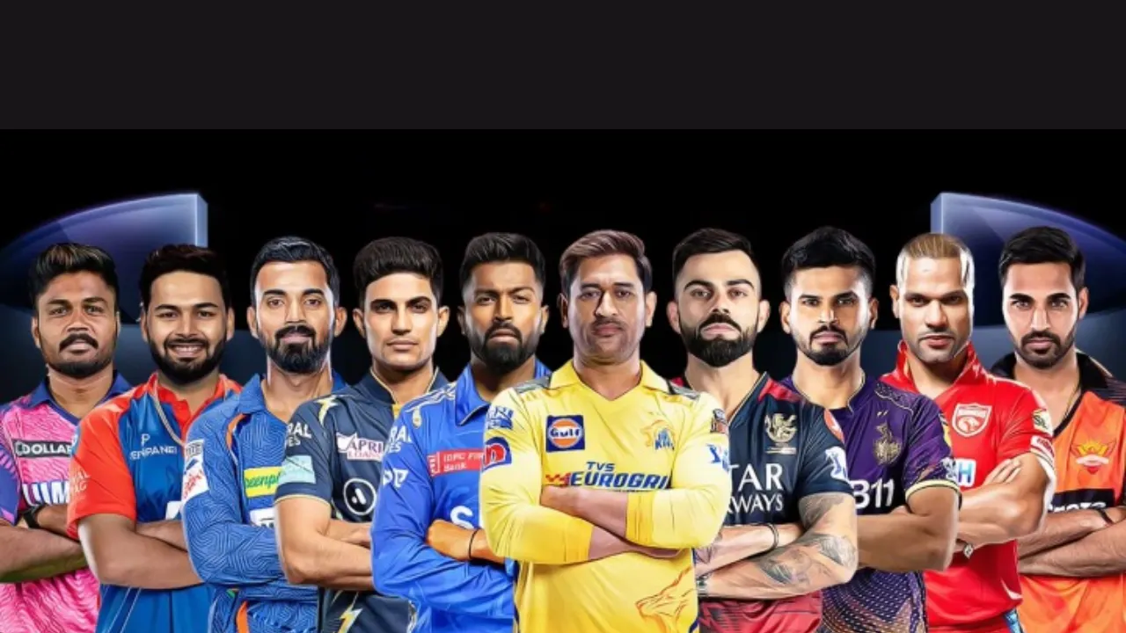
IPL Match Winner Prediction using Machine Learning
SANJAIKUMAR S
DA & DS FEB 2025
07-07-25

Slide 2

OBJECTIVE
Predict the winning team in IPL matches using historical match data.
Apply multiple machine learning algorithms.
Compare models and identify the best performer.
Save the best model for future predictions.

Slide 3
DATASET OVERVIEW
Source: IPL dataset from 2008–2019
Total Matches: 756
Important Columns: team1, team2, toss_winner, toss_decision, city, venue, win_by_runs, win_by_wickets, winner
Target Variable: winner

Slide 4
Removed rows with missing or invalid winner values
Filled missing city values with ‘Dubai’
Dropped unhelpful columns: umpire1, umpire2, umpire3, player_of_match
Corrected inconsistent team names
Removed outliers (both win_by_runs and win_by_wickets > 0 or both = 0)
DATA CLEANING

Slide 5
Feature Engineering
Label Encoding for target variable ‘winner’
One-Hot Encoding for categorical input features
Normalized numerical values
Final dataset prepared with all numerical inputs

Slide 6
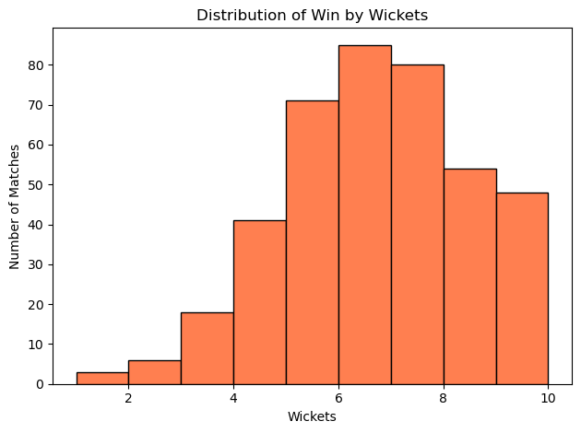
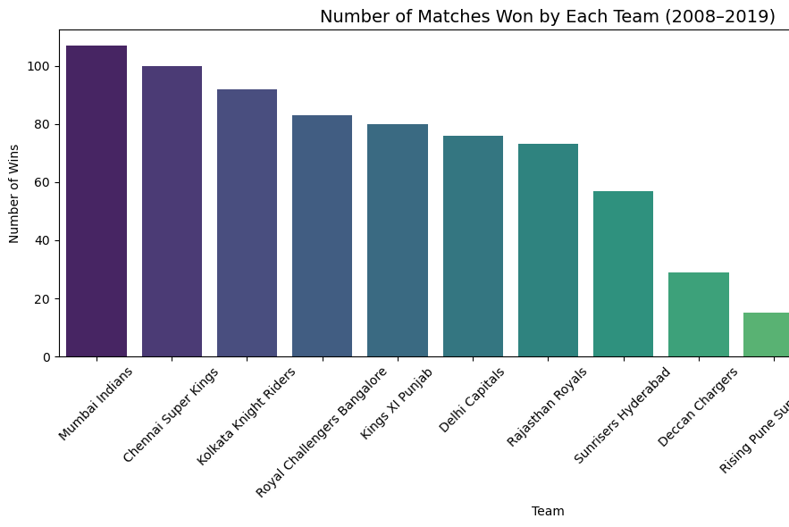
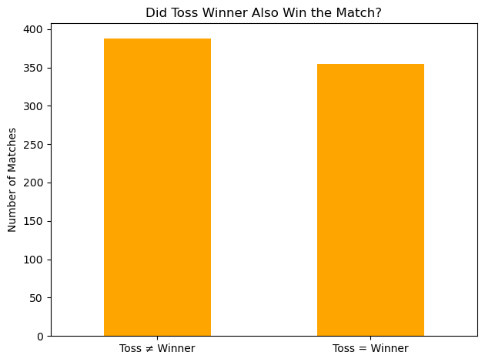
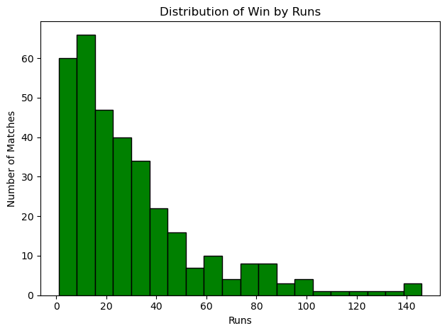
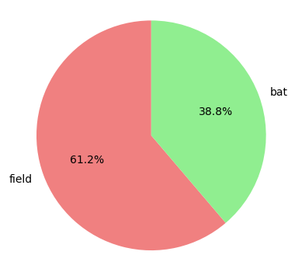
Exploratory Data Analysis (EDA)
Most Wins: Mumbai Indians, CSK
Toss Decision: Most teams prefer to field
Toss ≠ Match Win in many cases
Win by Runs mostly < 50
Win by Wickets mostly between 6–8

Slide 7

MODEL BUILDING
Applied 6 models:
Logistic Regression
Support Vector Machine
K-Nearest Neighbors
Decision Tree
Random Forest
XGBoost
Used GridSearchCV for hyperparameter tuning
Used SMOTE for class imbalance handling
Split data: 80% train, 20% test

Slide 8
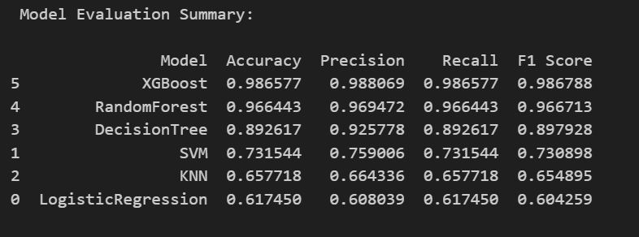
MODEL EVALUATION METRICS
Accuracy
Precision
Recall
F1-Score

Slide 9
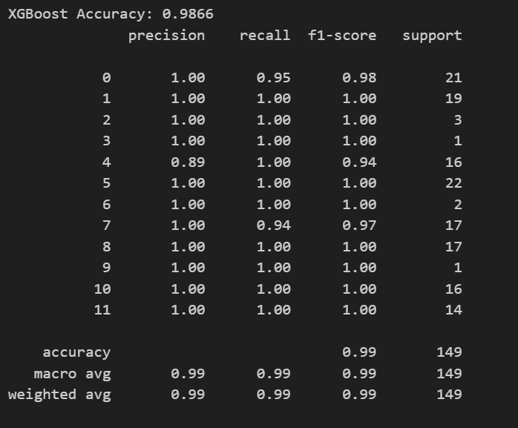
Best Performing Model
Model Name : XGBoost
Accuracy : 0.9866
Precision : 0.9881
Recall : 0.9866
F1 Score : 0.9868

Slide 10
KEY INSIGHTS
Mumbai Indians and Chennai Super Kings are the most successful teams.
Most teams prefer to field first after winning the toss.
Toss winner doesn't always win the match — only a slight advantage.
Teams batting first usually win by 10–40 runs; chasing teams by 6–8 wickets.
XGBoost and Random Forest gave the best prediction results.
Applied SMOTE to handle team imbalance in the data.

Slide 11

CONCLUSION
Successfully cleaned and prepared IPL match data from 2008 to 2017.
Performed detailed Exploratory Data Analysis to identify patterns in match outcomes.
Applied machine learning models like Random Forest, XGBoost, and Logistic Regression.
Used SMOTE and GridSearchCV to handle imbalance and optimize model performance.
XG Boost delivered the best performance based on F1 Score and accuracy.
Model can predict the winner based on match conditions like toss, teams, and venue.

Slide 12
THANK U

